Slide 1

Code Coverage Metrics
…And How to Use (and Misuse) Them
#include <stdio.h>
main()
{
int i, n, pp, p, c;
printf("Enter element count: ");
scanf("%d", &n);
if (n < 0) {
printf("No %d series!\n", n);
n = -1;
} else {
printf("{ ");
pp = 0;
p = 1;
for (i=0; i < n; i++) {
c = pp + p;
printf("%d ", c);
pp = p;
p = c;
}
printf("} \n");
}
exit(n);
}
Rex Black
RBCS, Inc.
31520 Beck Road
Bulverde, TX 78163 USA
Phone: +1 (830) 438-4830
Fax: +1 (830) 438-4831
www.rexblackconsulting.com
rex_black@rexblackconsulting.com

Slide 2

White Box Testing
What is white box testing?
How do we do white box testing?
  Statement, branch, condition, multicondition, multicondition decision, and loop coverage
  McCabe basis paths
  Set-use pair (dataflow) coverage
  Checklist-based test requirements
How does white box testing compare to other types of testing?
Can tools help with the tedious bits?
What bugs does white box testing miss?

Slide 3
What Is White Box Testing?
Dynamic test (compiled, executable)
  Execute the item under test
  Create test conditions (e.g., submit inputs)
  Compare expected and actual results
Pure requirements-based tests can miss 80% or more of the code: Do you know which 80% you are not testing?
Test design based on how the system works
  Figure out the control flows
  Figure out data flows
  Check against standard checklists or bug taxonomies
Let’s look at these in more detail

Slide 4
Code-Based Testing
Creating tests to achieve levels of coverage
  Statement coverage: every statement executed
  Branch coverage: every branch (decision) taken each way, true and false
  Condition coverage: every condition evaluated once true and once false
  Multicondition coverage: for compound conditions, every possible combination of constituent conditions covered
  Multicondition decision coverage: for compound conditions, every possible combination of constituent conditions that can affect the decision covered
  Loop coverage: Ideally all possible loop paths taken, but usually loop paths taken zero, once, and multiple (ideally, maximum) times

Slide 5
Code Coverage Example
1 main()
2 {
3 int i, n, pp, p, c;
4 printf("Enter element count: ");
5 scanf("%d", &n);
6 if (n < 0) {
7 printf("No %d series!\n", n);
8 n = -1;
9 } else {
10 printf("{ ");
11 pp = 0;
12 p = 1;
13 for (i=0; i < n; i++) {
14 c = pp + p;
15 printf("%d ", c);
16 pp = p;
17 p = c;
18 }
19 printf("} \n");
20 }
21 exit(n);
22 }
What test values for n do
we need to cover all the statements?
  n < 0, n > 0
Does that get us branch coverage?
  No, need to add n = 0
Does that get us condition coverage?
  Yes: no compound conditions
How about loop coverage?
  Need to cover n = 1 and
  n = max

Slide 6
Variations on Condition Coverage
So, when do condition coverage, multicondition coverage, and multicondition decision coverage vary?
How many tests for each type of coverage for lines 1-5?
How about for lines 7-11?
Does multicondition coverage even make sense for lines 7-11?
Let’s compare the testing for lines 1-5 with lines 13-17
1 if ((a>0) && (b>a)) {
2 printf(”Success.\n”);
3 } else {
4 printf(”Failure.\n”);
5 }
6
7 if ((f!=NULL) && (*f==0)) {
8 printf(”Found.\n”);
9 } else {
10 printf(”Not found.\n”);
11 }
12
13 if ((a<=0) || (b<=a)) {
14 printf(”Failure.\n”);
15 } else {
16 printf(”Success.\n”);
17 }

Slide 7
McCabe Cyclomatic Complexity
McCabe’s Cyclomatic Complexity measures control flow complexity
  Measured by drawing a directed graph
  Nodes represent entries, exits, decisions
  Edges represent non-branching statements
It has some useful testing implications
  High-complexity modules are inherently buggy and regression-prone
  The number of basis paths through the graph is equal to the number of basis tests to cover the graph
Let’s see how…

Slide 8
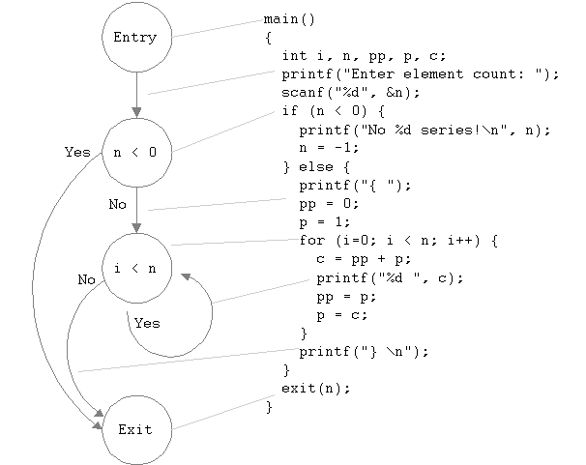
Cyclomatic Complexity for Fibonacci
Cyclomatic Complexity
C = #Regions + 1
= 2 + 1 = 3
C = #Edges - #Nodes +2
= 5 - 4 +2 = 3

Slide 9
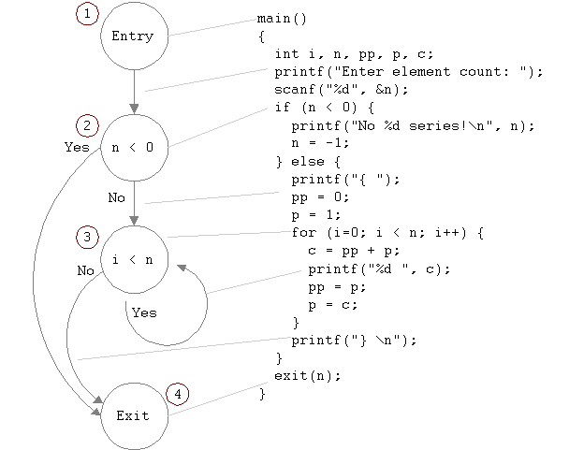
Basis Paths and Tests
Basis Paths
1. 124
2. 1234
3. 12334
Basis Tests
1. n = -1
2. n = 0
3. n = 1

Slide 10
Analyzing Data Flow Set-Use Pairs
So far, we’ve focused on testing control flows
How about testing data flows?
We can analyze data flows using set-use pair coverage
Do we cover every variable set-and-subsequent-use (assigning the variable a value, then using that variable, but before assigning the variable again)?

Slide 11
Data Flow Coverage Example
i: (13,13)
  n=0 covers assign-use
  n=1 covers increment-use
n: (5,6), (5,13), (5,21), (8,21)
  n=-1 covers (5,6), (8,21)
  n=0 adds (5,13), (5,21)
pp: (11,14),(16,14)
  n=1 covers (11,14)
  n=max adds (16,14)
p: (12,14), (12,16), (17,14)
  n=1 covers (12,14)
  n=max adds (12,16), (17,14)
c: (14,15), (14,17)
  n=1 covers (14,15)
  n=max adds (14,17)
Basis cover != data-flow cover
  For c into p into pp into c, iterate loop three times
1 main()
2 {
3 int i, n, pp, p, c;
4 printf("Enter element count: ");
5 scanf("%d", &n);
6 if (n < 0) {
7 printf("No %d series!\n", n);
8 n = -1;
9 } else {
10 printf("{ ");
11 pp = 0;
12 p = 1;
13 for (i=0; i < n; i++) {
14 c = pp + p;
15 printf("%d ", c);
16 pp = p;
17 p = c;
18 }
19 printf("} \n");
20 }
21 exit(n);
22 }

Slide 12
Checklist-based Test Requirements
Tests can be designed based on a catalog of test requirements, a bug taxonomy or other checklists of important aspects to be tested
Frequent program operations combined with typical buggy aspects of those operations make a good catalog of test requirements
Select test requirements; cover with tests
Let’s test Fibonacci with Brian Marick’s catalog, from The Craft of Software Testing
Click here to see the test requirements catalog, available at www.testing.com
Click here to see the tests developed using the test requirements catalog

Slide 13
A Basic Catalog-Based Test Design Process
Review requirements, design, code, and data structures
  Compare each element to checklist or catalog
  Accumulate clues and test requirements
Design tests to cover the test requirements
  Avoid covering multiple error-related test requirements in one test where possible
  Seek as much test variety as possible
Run tests

Slide 14
Comparing Techniques
 | Static | White box | Black box
What | Test without running | Test how system works | Test what system does
Why | Identify bugs before they’re built | Identify bugs in functions or interfaces | Identify bugs in system results and behavior
Who | All stakeholders | Typically developers | Typically testers
Phase | During specification and development | Usually unit, component, integration | Usually integration, system, and acceptance
Tools | Simulators, code analyzers, spell- and grammar checkers, graphic/diagramming, spreadsheets | Profilers, coverage analyzers, harnesses, debuggers, data generators, test case generators | Intrusive and non-intrusive GUI tools, load generators, performance tools, data generators
Tools, data, and cases can be shared: encourage cross-pollination of techniques

Slide 15
What a Tedious Chore!
Trying to measure metrics like control-flow coverage and Cyclomatic Complexity is not a fun pastime
Fortunately, there are tools that can help
It’s harder to find data-flow coverage tools
Anyone have a test catalog coverage tool?

Slide 16
What Can’t White Box Tests Find?
As essential as it is to have well-tested units and builds, white box testing can’t find every kind of bug
Bugs of omission
  Missing requirements, design elements, code
  Use requirements, design and code reviews
Unmaintainable code
  Inscrutable variable names or constructs, etc. (though McCabe complexity helps)
  Use code reviews and static analysis tools
Systemic problems
  Performance, security, usability, interoperability, etc.
  Use code reviews, black-box system testing, beta/pilot tests, usability studies, prototyping, etc.

Slide 17
Conclusions
White box testing is…
  dynamic testing (running item under test)…
  based on knowledge of how it works
There are four main theoretical techniques
  Statement, branch, condition, and loop coverage
  Basis paths
  Set-use pair (dataflow) coverage
  Test requirements catalogs
White box testing is complementary to…
  black box testing
  static testing
Use all three to form a complete testing strategy

Slide 18
Recommended Readings
For test techniques
Software Testing Techniques, Boris Beizer
Pragmatic Software Testing, Rex Black
The Craft of Software Testing, Brian Marick
To create useful programs to try out white box techniques
The C Programming Language, Brian Kernighan and Dennis Ritchie
The Unix Programming Environment, Brian Kernighan and Rob Pike
The C++ Programming Language, Bjarne Stroustroup

